Slide 1
University Tycoon
Team Four:
Meghan Tennant
Tyler Adkins
Kent Irvin
George Hinkel

Slide 2
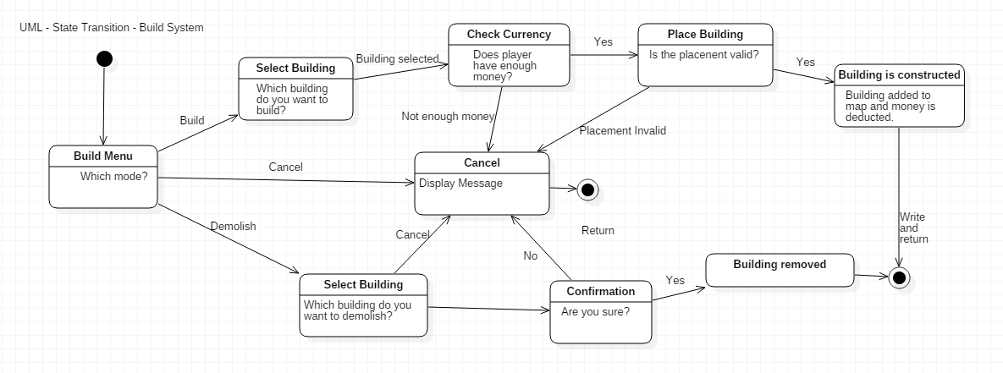
Build System Diagram

Slide 3
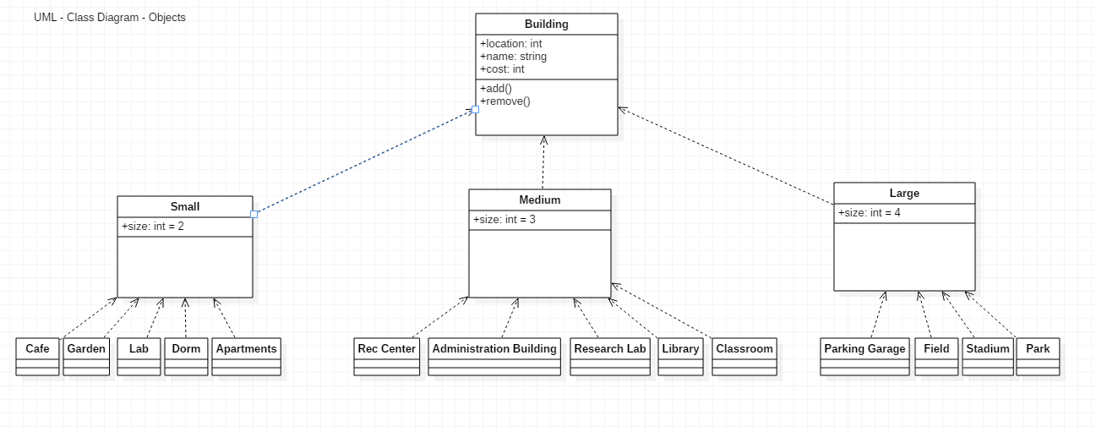
Objects Diagram

Slide 4
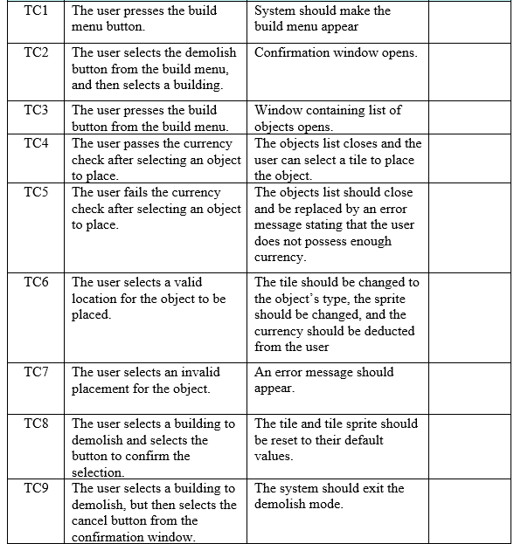
Build System Test Cases

